Slide 1
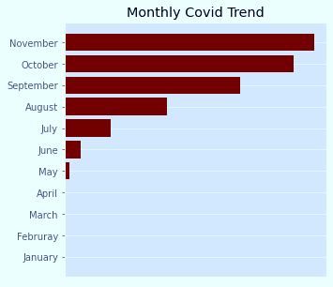
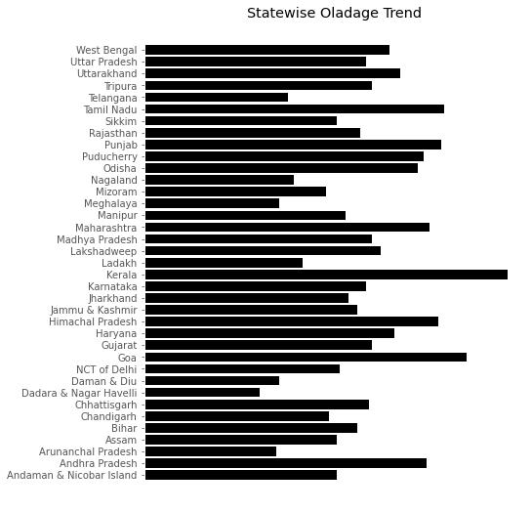
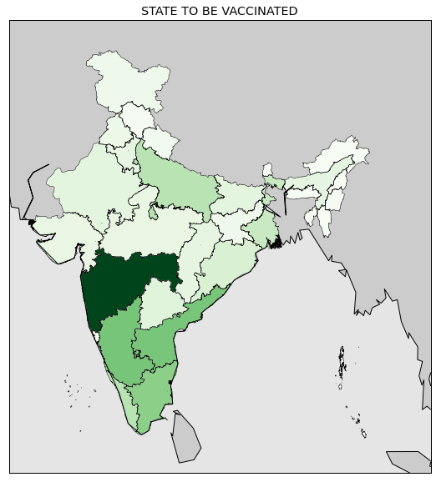
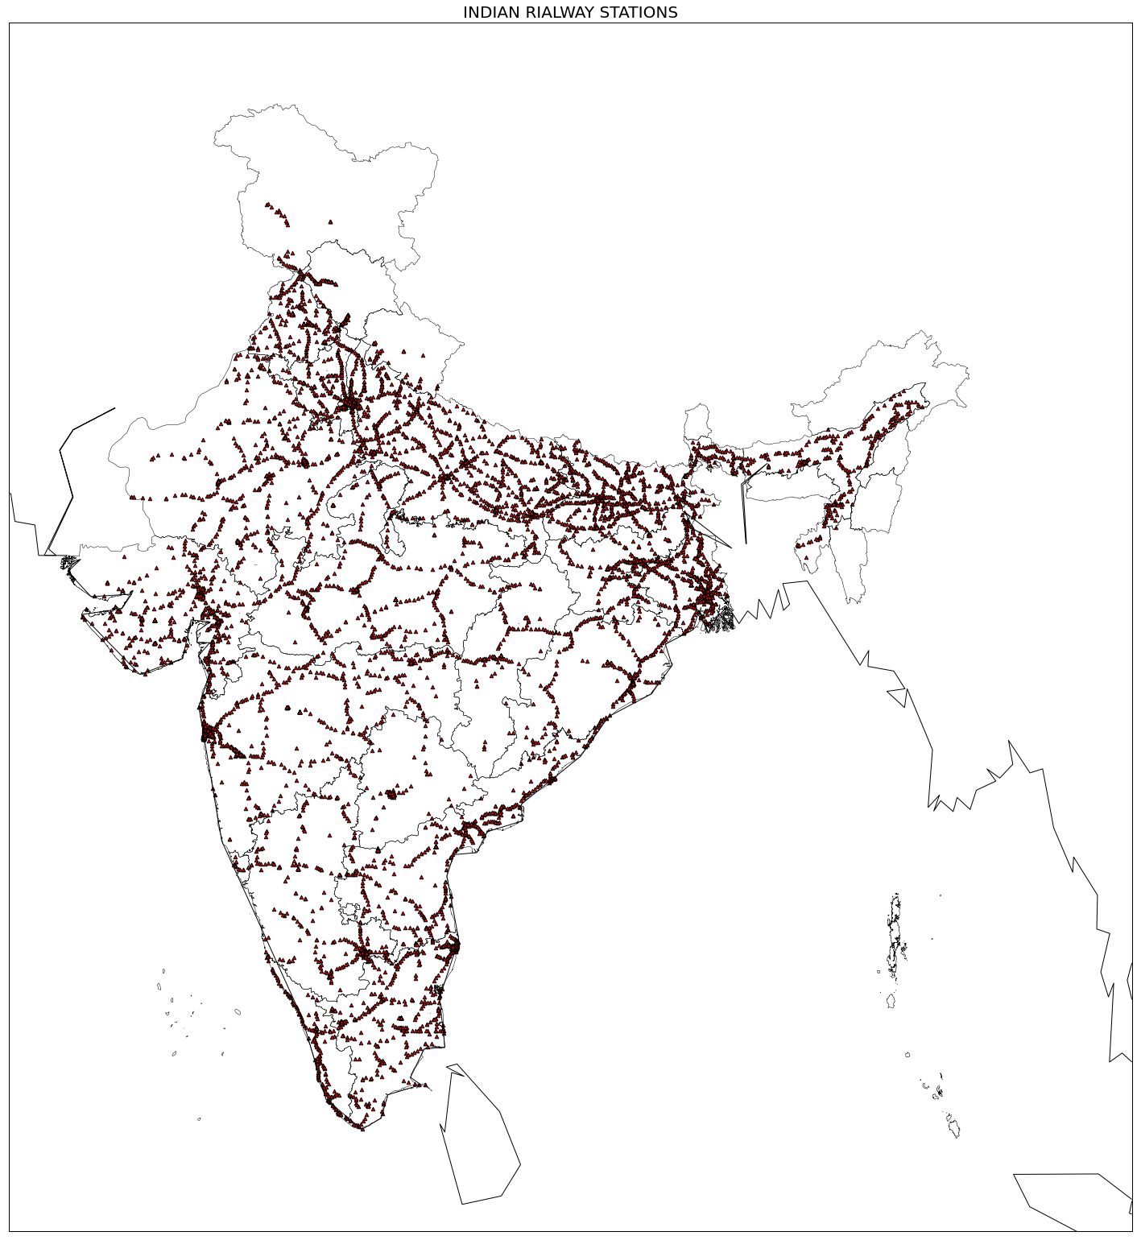
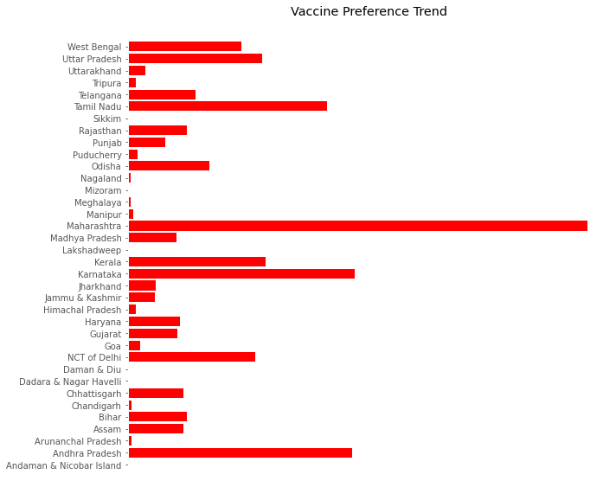
GUIDE TO COVID VACCINE REPORT
Railway Station
This report take three parameters to find the solution of vaccine distribution in India.
1.It takes monthly Covid trend
2.It takes state wise oldage trend
3.It takes number of railway station of the country for transportation of vaccine
Before giving the trend for most vaccine needed state

